Slide 1



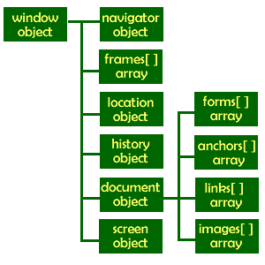

Introduction to DOM and Events
Create / Delete DOM Elements
Handle Browser Events
DOM Manipulation & Events
SoftUni Team
Technical Trainers
Software University
http://softuni.bg

Slide 2



Table of Contents
What is DOM?
Manipulating the DOM
Create Elements
Delete Elements
Element Attributes
Event Handling
Attach / Detach Events

Slide 3
Have a Question?
sli.do #front-end

Slide 4
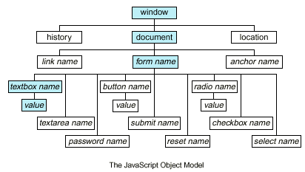
Document Object Model (DOM)
Traverse the DOM Tree

Slide 5
What is DOM?
What is Document Object Model (DOM)?
HTML documents in the browser are stored as "DOM tree"
Consists of elements with child elements
Elements have properties (attribute + value) and events
The DOM API allows search / modify the DOM tree
let menu = document.getElementById('menu');
menu.style.display = 'none';
menu.appendChild(document.createElement('hr'));

Slide 6
Selecting HTML Elements from DOM
Select a single element → returns HTML Element
Select a collection of elements → returns a collection
let header = document.getElementById('header');
let nav = document.querySelector('#main-nav');
let root = document.documentElement;
let inputs = document.getElementsByTagName('li');
let towns = document.getElementsByName('towns[]');
let header = document.querySelectorAll('#nav li');
let allLinks = document.links;

Slide 7
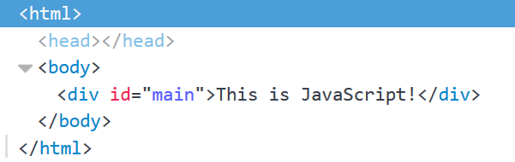
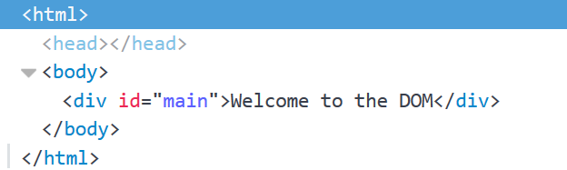
Accessing Element Text
The contents of HTML elements are stored in text nodes
To access the contents of an element:
If the element has children, returns all text concatenated
let element = document.getElementById('main');
let text = element.textContent; //This is JavaScript!
element.textContent = "Welcome to the DOM";

Slide 8
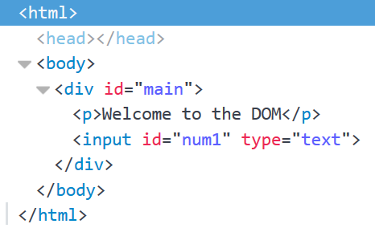
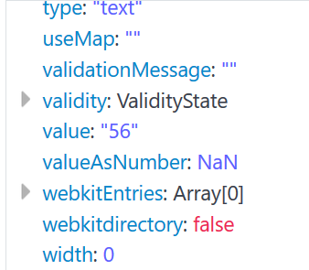
Accessing Element Values
The values of input elements are string properties on them:
let element = document.getElementById('num1');
let num = Number(element.value);
element.value = 56;

Slide 9

DOM API: Element Properties
<div id="first" class="big">First <b>DIV</b></div>
let div = document.getElementById('first');
console.log(div.id); // first
console.log(div.tagName); // DIV
console.log(div.className); // big
console.log(div.textContent); // First DIV
console.log(div.innerHTML); // First <b>DIV</b>
console.log(div.outerHTML); // <div id="first" class="big">First <b>DIV</b></div>

Slide 10
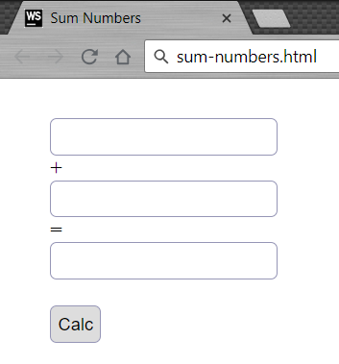
Problem: Sum Numbers
Write a JS function to sum two numbers (fill the missing code)
<input type="text" id="num1" /> +
<input type="text" id="num2" /> =
<input type="text" id="sum" readonly="readonly" />
<input type="button" value="Calc" onclick="calc()" />
<script>
function calc() {
// TODO: sum = num1 + num2
}
</script>

Slide 11
Solution: Sum Numbers
function calc() {
let num1 = document.getElementById('num1').value;
let num2 = document.getElementById('num2').value;
let sum = Number(num1) + Number(num2);
document.getElementById('sum').value = sum;
}
Check your solution here: https://judge.softuni.bg/Contests/1096

Slide 12
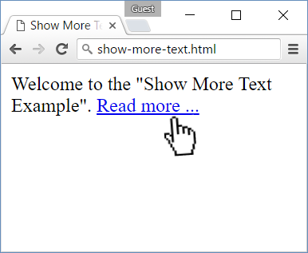
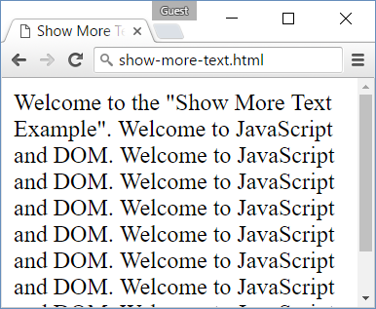
Problem: Show More Text
A HTML page holds a short text + link "Read more …"
Clicking on the link shows more text and hides the link

Slide 13
Problem: Show More Text – HTML
Welcome to the "Show More Text Example".
<a href="#" id="more" onclick= "showText()">Read more …</a>
<span id="text" style= "display:none">Welcome to …</span>
<script>
function showText() {
// TODO
}
</script>
See the DOM tree here: http://software.hixie.ch/utilities/js/live-dom-viewer/?saved=4275

Slide 14
Solution: Show More Text
Welcome to the "Show More Text Example". <a href="#" id="more" onclick="showText()">Read more …</a>
<span id="text" style="display:none">Welcome to …</span>
<script>
function showText() {
document.getElementById('text')
.style.display = 'inline';
document.getElementById('more')
.style.display = 'none';
}
</script>
Check your solution here: https://judge.softuni.bg/Contests/1096

Slide 15
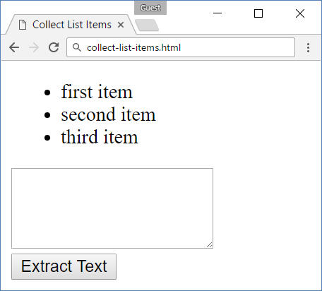
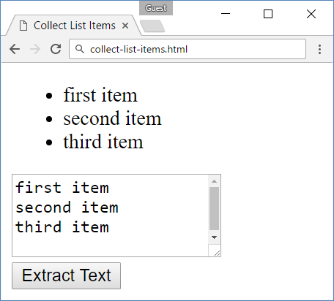
Problem: Collect List Items
Collect the list items from given HTML list and append their text to given text area

Slide 16
Problem: Collect List Items – HTML
<ul id="items">
<li>first item</li>
<li>second item</li>
<li>third item</li>
</ul>
<textarea id="result"> </textarea>
<br>
<button onclick="extractText()"> Extract Text</button>

Slide 17
Solution: Collect List Items
function extractText() {
let itemNodes =
document.querySelectorAll("ul#items li");
let textarea =
document.querySelector("#result");
for (let node of itemNodes) {
textarea.value += node.textContent + "\n";
}
}
Check your solution here: https://judge.softuni.bg/Contests/1096

Slide 18
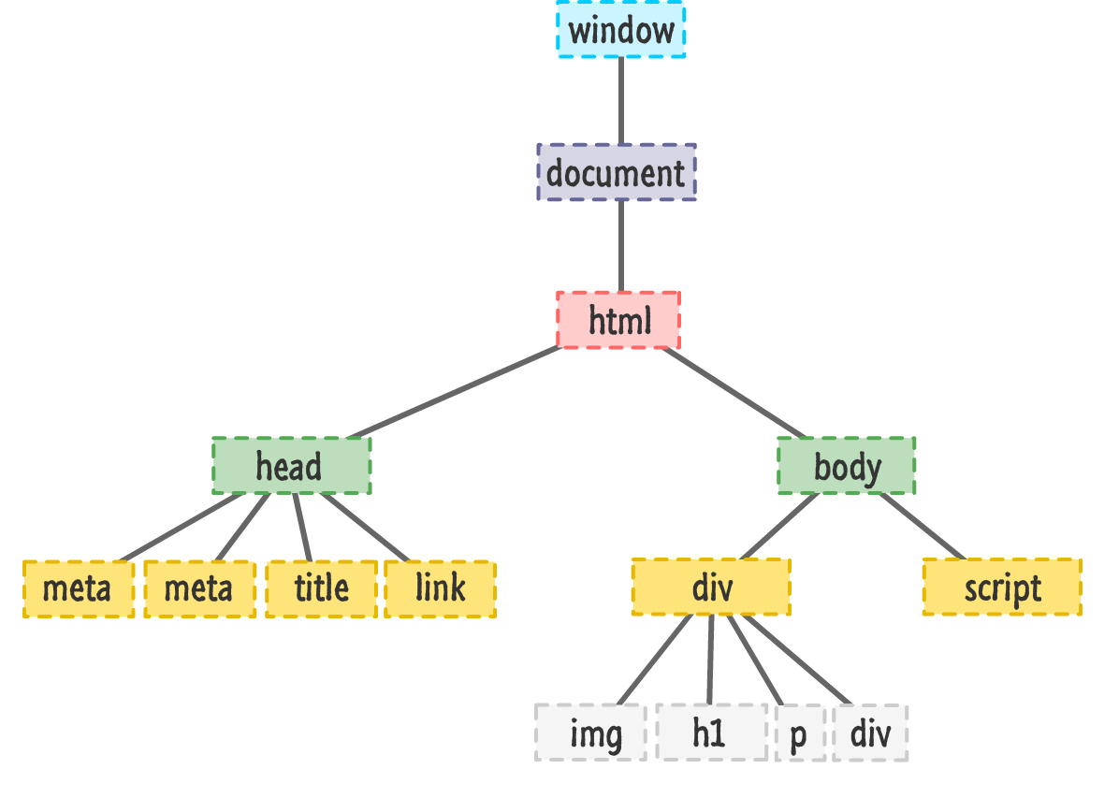
DOM Manipulation
Modify the DOM Tree

Slide 19
Creating New DOM Elements
HTML elements are created with document.createElement
Variables holding HTML elements are live:
If you modify the contents of the variable, the DOM is updated
If you insert it somewhere in the DOM, the original is moved
Text added to textContent will be escaped
Text added to innerHTML will be parsed and turned into actual HTML elements

Slide 20
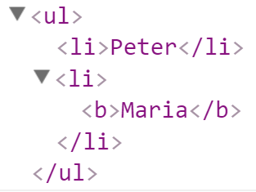
Creating New DOM Elements: Examples
let list = document.createElement("ul");
let liPeter = document.createElement("li");
liPeter.textContent = "Peter";
list.appendChild(liPeter);
let liMaria = document.createElement("li");
liMaria.innerHTML = "<b>Maria</b>";
list.appendChild(liMaria);
document.body.appendChild(list);

Slide 21
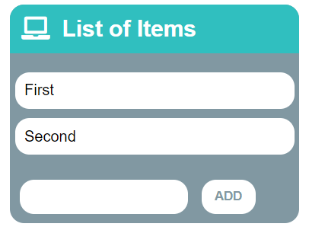
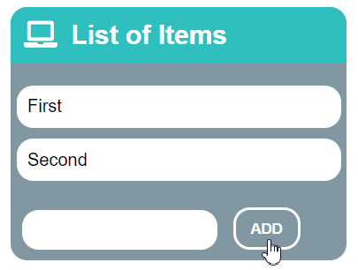
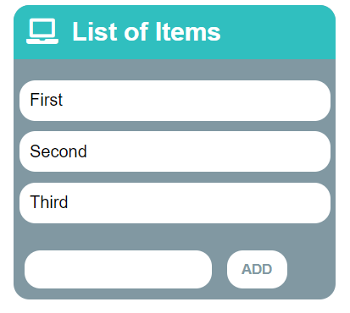
Problem: List of Items
Create a HTML page holding a list of items + text box + button for adding more items to the list
Write a JS function to append the specified text to the list

Slide 22
Problem: List of Items – HTML
<h1>List of Items</h1>
<ul id="items"><li>First</li><li>Second</li></ul>
<input type="text" id="newItemText" />
<input type="button" value="Add" onclick="addItem()">
<script>
function addItem() {
// TODO: add new item to the list
}
</script>

Slide 23
Solution: List of Items
function addItem() {
let text =
document.getElementById('newItemText').value;
let li = document.createElement("li");
li.appendChild(document.createTextNode(text));
document.getElementById("items").appendChild(li);
document.getElementById('newItemText').value = '';
}
Check your solution here: https://judge.softuni.bg/Contests/1096

Slide 24
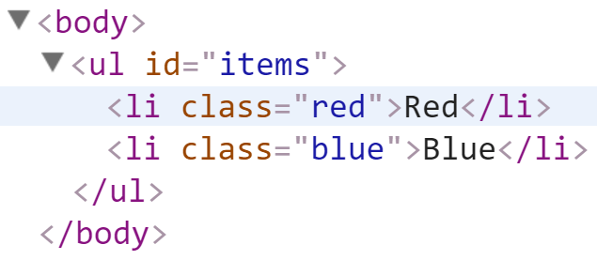
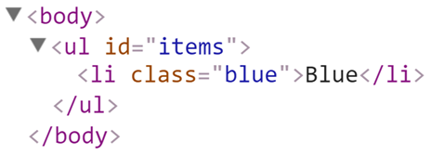
Deleting DOM Elements
<ul id="items">
<li class="red">Red</li>
<li class="blue">Blue</li>
</ul>
let redElements =
document.querySelectorAll("#items li.red");
redElements.forEach(li => {
li.parentNode.removeChild(li);
});

Slide 25
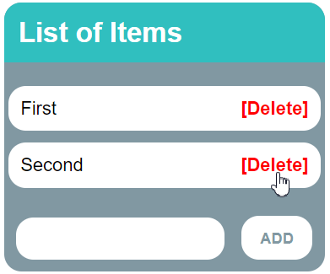
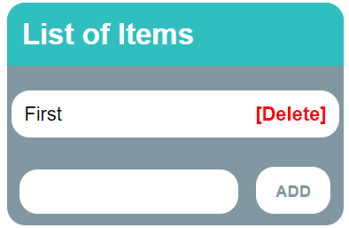
Problem: Add / Delete Items
Extend the previous problem
Implement [Delete] action as link after each list item

Slide 26
Problem: Add / Delete Items – HTML
<h1>List of Items</h1>
<ul id="items"></ul>
<input type="text" id="newText" />
<input type="button" value="Add" onclick="addItem()">
<script>
function addItem() { ...
function deleteItem() { ... }
}
</script>

Slide 27
Solution: Add / Delete Items
function addItem() {
let text = document.getElementById('newText').value;
let li = document.createElement("li");
li.appendChild(document.createTextNode(text + " "));
let span = document.createElement('span');
span.innerHTML = "<a href='#'>[Delete]</a>";
span.firstChild.addEventListener('click', deleteItem);
li.appendChild(span);
document.getElementById("items").appendChild(li);
document.getElementById('newText').value = '';

Slide 28
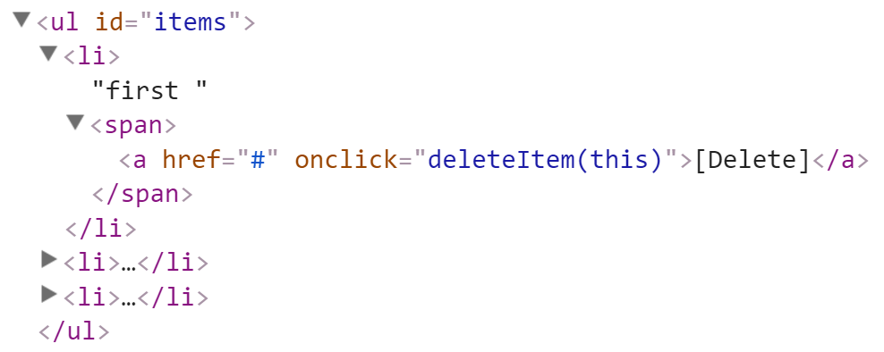
Solution: Add / Delete Items (2)
function deleteItem() {
let li = this.parentNode.parentNode;
let ul = li.parentNode;
ul.removeChild(li);
}
}
this.parentNode.parentNode == li
this.parentNode == span
this holds the clicked hyperlink
Check your solution here: https://judge.softuni.bg/Contests/1096

Slide 29

Practice: DOM and Events
Live Exercises in Class (Lab)

Slide 30


Summary
Browsers keep elements as DOM tree
Finding / modifying DOM elements:
Handling events:
let menu = document.getElementById('menu');
menu.style.display = 'none';
menu.appendChild(
document.createElement('hr'));
let menu = document.getElementById('menu');
menu.onclick = function(event) { … }

Slide 31







JS for Front-end – Intro to DOM and Events
https://softuni.bg/courses/javascript-for-front-end

Slide 32






SoftUni Diamond Partners

Slide 33






SoftUni Diamond Partners

Slide 34
License
This course (slides, examples, demos, videos, homework, etc.) is licensed under the "Creative Commons Attribution-NonCommercial-ShareAlike 4.0 International" license

Slide 35





Trainings @ Software University (SoftUni)
Software University – High-Quality Education, Profession and Job for Software Developers
softuni.bg
Software University Foundation
http://softuni.foundation/
Software University @ Facebook
facebook.com/SoftwareUniversity
Software University Forums
forum.softuni.bg

